Slide 1
Activity Planning

Slide 2
Introduction
A plan also includes scheduling, indicating start and completion time for each activity.
Activity Planning is important:
Ensure timely resource availability.
Avoid resource conflicts.
Show who does what task.
Set measurable achievement targets.
Enable replanning if things go off track.
Predict cash flow

Slide 3
Objectives of Activity Planning
Feasibility Assessment:
Checks if the project can be done within the given time and resources.
Requires:
A detailed plan.
Understanding of staff availability and parallel work feasibility.
Resource Allocation:
Answers:
Who needs what?
When will resources be available?
Explores:
How adding resources affects time.
Efficient use of limited staff.

Slide 4
Objectives of Activity Planning
Detailed Costing
Estimates:
How much the project will cost.
When expenses will occur.
Useful for budgeting and control.
Motivation
Targets = Motivation.
Helps teams stay focused and committed.

Slide 5
Objectives of Activity Planning
Coordination
Answers:
When do staff need to be shifted?
How can teams communicate better?
Important for:
Projects with multiple teams/departments.
Ensuring smooth resource transfer between tasks or phases.

Slide 6
When to plan
Planning is an ongoing process of refinement.
As the project proceeds beyond the feasibility study, the emphasis is placed on planning activities.
Till the final deliverable has reached the customer, monitoring and replanning should continue.

Slide 7
Project Schedule
A project schedule is a plan that shows:
When each activity starts and finishes,
How much of each resource is needed?
It’s developed in four stages:
Decide on the activities and their order.
Create an ideal activity plan (assuming no constraints).
Conduct an activity risk analysis (to identify issues).
Allocate resources realistically and generate the final schedule.

Slide 8
Projects and Activities
Defining Activities
A project is composed of a number of inter-related activities.
A project may start when atleast one of its activity is ready to start.
An activity must have a clearly defined start-point and a clearly defined end-point.
If an activity requires a resource (e.g., personnel or equipment), that requirement must be forecastable.
The duration of an activity must be forecastable.
Some activities might require that others are completed before they can begin.
The project network should not contain any loops.
Each activity must be bounded in terms of the resources and time it uses.

Slide 9
Projects and Activities
Identifying Activities
Three approaches
Activity-based approach
Product-based approach
Hybrid approach

Slide 10
Activity-based approach
Creating a list of all activities.
This list can come from:
A brainstorming session with the project team
An analysis of similar past projects
For large projects: Break the project into main lifestyle stages (like design, development, testing, etc.) and identify activities under each.
Risk of doing it manually:
Might miss activities
Or duplicate some

Slide 11
Activity-based approach
Work Break Down Structure (WBS) is preferred method of identifying and organizing project tasks.
How WBS works:
Identify the main tasks (high-level)
Break them down into smaller sub-tasks
Keep breaking down until you reach clearly manageable and actionable tasks
Rule for adding activities to a branch:
Add a task only if it directly contributes to the task just above it in the hierarchy
If it doesn’t, it should not be part of that branch

Slide 12
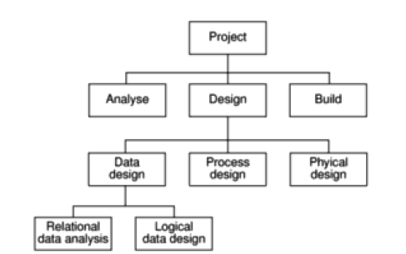
Activity-based approach

Slide 13
Activity-based approach
Assumptions / Considerations Made When Using WBS:
Completeness of Tasks:
Every task at a lower level must fully define what is needed for the higher-level task.
If the subtasks do not cover the entire parent task, something is missing.
Depth of Structure:
Too much depth = too many small tasks → difficult to manage.
Too little depth = insufficient detail for project control.
Need a balance based on manageability and control.
Level of Breakdown:
Tasks should be broken down enough so that each one can be assigned to an individual or a unit.

Slide 14
Activity-based approach
Clarity and Non-overlap:
Ensures the task list is complete and non-overlapping.
Only the leaves of the WBS (i.e., the bottom-level tasks) are considered as real, actionable activities.
Refinement Over Time:
WBS can be refined as the project progresses.
Initially, a shallow or high-level WBS may be used during the early planning stages.
Foundation for Sequencing:
Once tasks are identified (with or without WBS), they must be sequenced – deciding which tasks depend on others.
Adaptability:
WBS allows for modification as more project information becomes available, especially during analysis/specification phases.

Slide 15
Product-based approach
Product-Based Planning is a planning technique where you focus on the deliverables (products) first — before thinking about the activities (tasks) needed to produce them.
Key Idea: “First decide what needs to be delivered, then figure out how to deliver it.”
Why Use Product-Based Planning?
It ensures nothing important is missed.
It gives a clear picture of all outputs.
It helps you focus on goals and results, not just busy tasks.

Slide 16
Product-based approach
What is a "Product"?
In this context, a product is anything you deliver during the project. Examples:
A report
A software module
A data catalog
A training manual
A test plan

Slide 17
Product-based approach
Steps in Product-Based Planning
List all products (big and small) that the project must deliver
This forms the Product Breakdown Structure (PBS).
Determine the order in which products are needed or depend on each other
This forms the Product Flow Diagram (PFD).
Figure out the tasks required to build each product
This creates the Work Breakdown Structure (WBS).

Slide 18
Hybrid approach
It means combining both Product-Based and Activity-Based WBS.
You first decide what to build (the products), then you plan how to build them (the activities).

Slide 19
Sequencing and Scheduling Activities
Sequencing:
Determining the logical order in which activities should be performed.
Based on dependencies: Some tasks must be completed before others can start.
Scheduling:
Assigning specific times (start/end dates) to activities, respecting the sequence.
Involves
Estimating durations
Considering resources available
Allocating time buffers

Slide 20
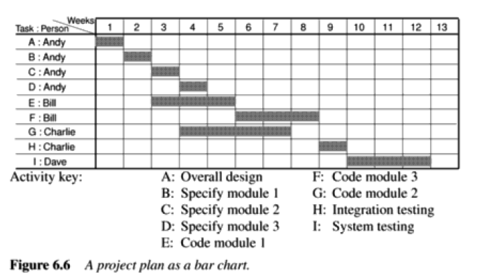
Sequencing and Scheduling Activities

Slide 21
Network planning Models
Project scheduling techniques model the project activities and their relationships as a network.
Two models are
PERT (Program Evaluation Review Technique)
CPM (Critical Path Method)

Slide 22
Formulating Network Model
CPM is a project scheduling technique used to model project activities and their relationships as a network. It helps to:
Determine the sequence of tasks (activities),
Identify dependencies between tasks,
Highlight the critical path – the longest sequence of tasks that determines the minimum project duration.

Slide 23
Basic Concepts of CPM
1. Network Representation
Activities are shown as arrows/links.
Events (starting or finishing points) are shown as nodes/circles.
Start node = where the project begins
End node = where the project finishes

Slide 24
Basic concepts of CPM
1. A project network may have only one start node
There is only one starting event (e.g., node 1).
All starting activities branch from this.
2. A project network may have only one end node
The network has one completion point (e.g., node 10).
This marks the end of the project.
3. A link has a duration
Each link is an activity that has a duration.
Example: “Code/test module B” is a task that takes time.
4. Nodes have no duration
Nodes are just events in time.
A node doesn’t take time; it shows that an activity has started or finished.

Slide 25
Basic concepts of CPM
5. Time moves from left to right
Time flows left to right.
Arrows indicate sequence and dependencies.
6. Nodes are numbered sequentially
Events are numbered sequentially to avoid confusion.
Head nodes (end) should have a higher number than tail nodes (start).
7. A network may not contain loops
Loops (circular paths) are not allowed in CPM.
It indicates a logical error, like an infinite task cycle.
8. A network may not contain dangles

Slide 26
Basic concepts of CPM

Slide 27
Basic concepts of CPM
8. A network may not contain dangles
A dangle is a logical flaw in an activity network (like a CPM or PERT chart), where an activity ends without connecting to a succeeding activity or to the project's final completion node.
All events, except first and last, must have at least one activity entering them and one activity leaving them and all activities must start and end with an event.

Slide 28
Basic concepts of CPM
9. Precedents are the immediate preceding activities

Slide 29
Using dummy activities
When two paths within a network have a common event, in other respects independent.

Slide 30
Using dummy activities

Slide 31
Using dummy activities

Slide 32
Representing lagged activities
Undertake two activities in parallel as long as there is a lag between two.

Slide 33
Adding the time dimension

Slide 34
Adding the time dimension

Slide 35
Forward pass
Forward pass is used to calculate the earliest start date and finish date.

Slide 36
Forward pass
Forward pass is used to calculate the earliest start date and finish date.

Slide 37
Backward Pass
The backward pass is a technique used to calculate the latest times each activity can start and finish without delaying the overall project.

Slide 38
Backward Pass
The backward pass is a technique used to calculate the latest times each activity can start and finish without delaying the overall project.

Slide 39
Identifying Critical Path
The difference between the earliest date and the latest date for an event is known as slack.
It tells you how much you can delay an activity without affecting the project deadline.
Any event with slack zero is critical.
There will always be at least one path through the network joining these events, and this path is known as the critical path.

Slide 40
Identifying Critical Path

Slide 41
Activity Float
What if A and C uses float?

Slide 42
Activity Float
What are other measures?
Free Float
Interfering Float
Free Float:
The amount of time an activity can be delayed without delaying the start of its immediate successor.
Free Float=Earliest Start of Successor−Earliest Finish of Activity
Interfering Float:
The portion of Total Float that, if used, delays successor activities but not the project.
Interfering Float=Total Float−Free Float

Slide 43
Activity Float

Slide 44
Shortening the project duration
Reduce activity duration -> reduction in total duration
In many cases, it will be done
Working overtime
Applying more resources
Additional staff
Shorten the critical activities

